Slide 1
Geospatial Clustering and Forecasting for Global Hotspots
Project Advisor: Prof. Dan Harkey
Harshada Baswaraj Jivane, harshadabaswaraj.jivane@sjsu.edu
Lakshmi Vihita Kesiraju, lakshmivihita.kesiraju@sjsu.edu Summohan Reddy Mallannagari, summohanreddy.mallannagari@sjsu.edu
Vamsi Krishna Chakravartula, vamsikrishna.chakravartula@sjsu.edu

Slide 2
Introduction
Advancements in the technologies and analytical methods are key aspects in acknowledging the spatial spread of COVID-19 disease pandemic that include Interactive web-based maps and dashboards for quick understanding of reasons for illness.
This web-based application would monitor the patient inflow, availability in nearest hospitals to visualize the information of resources in order to provide improved services to the COVID patients.

Slide 3
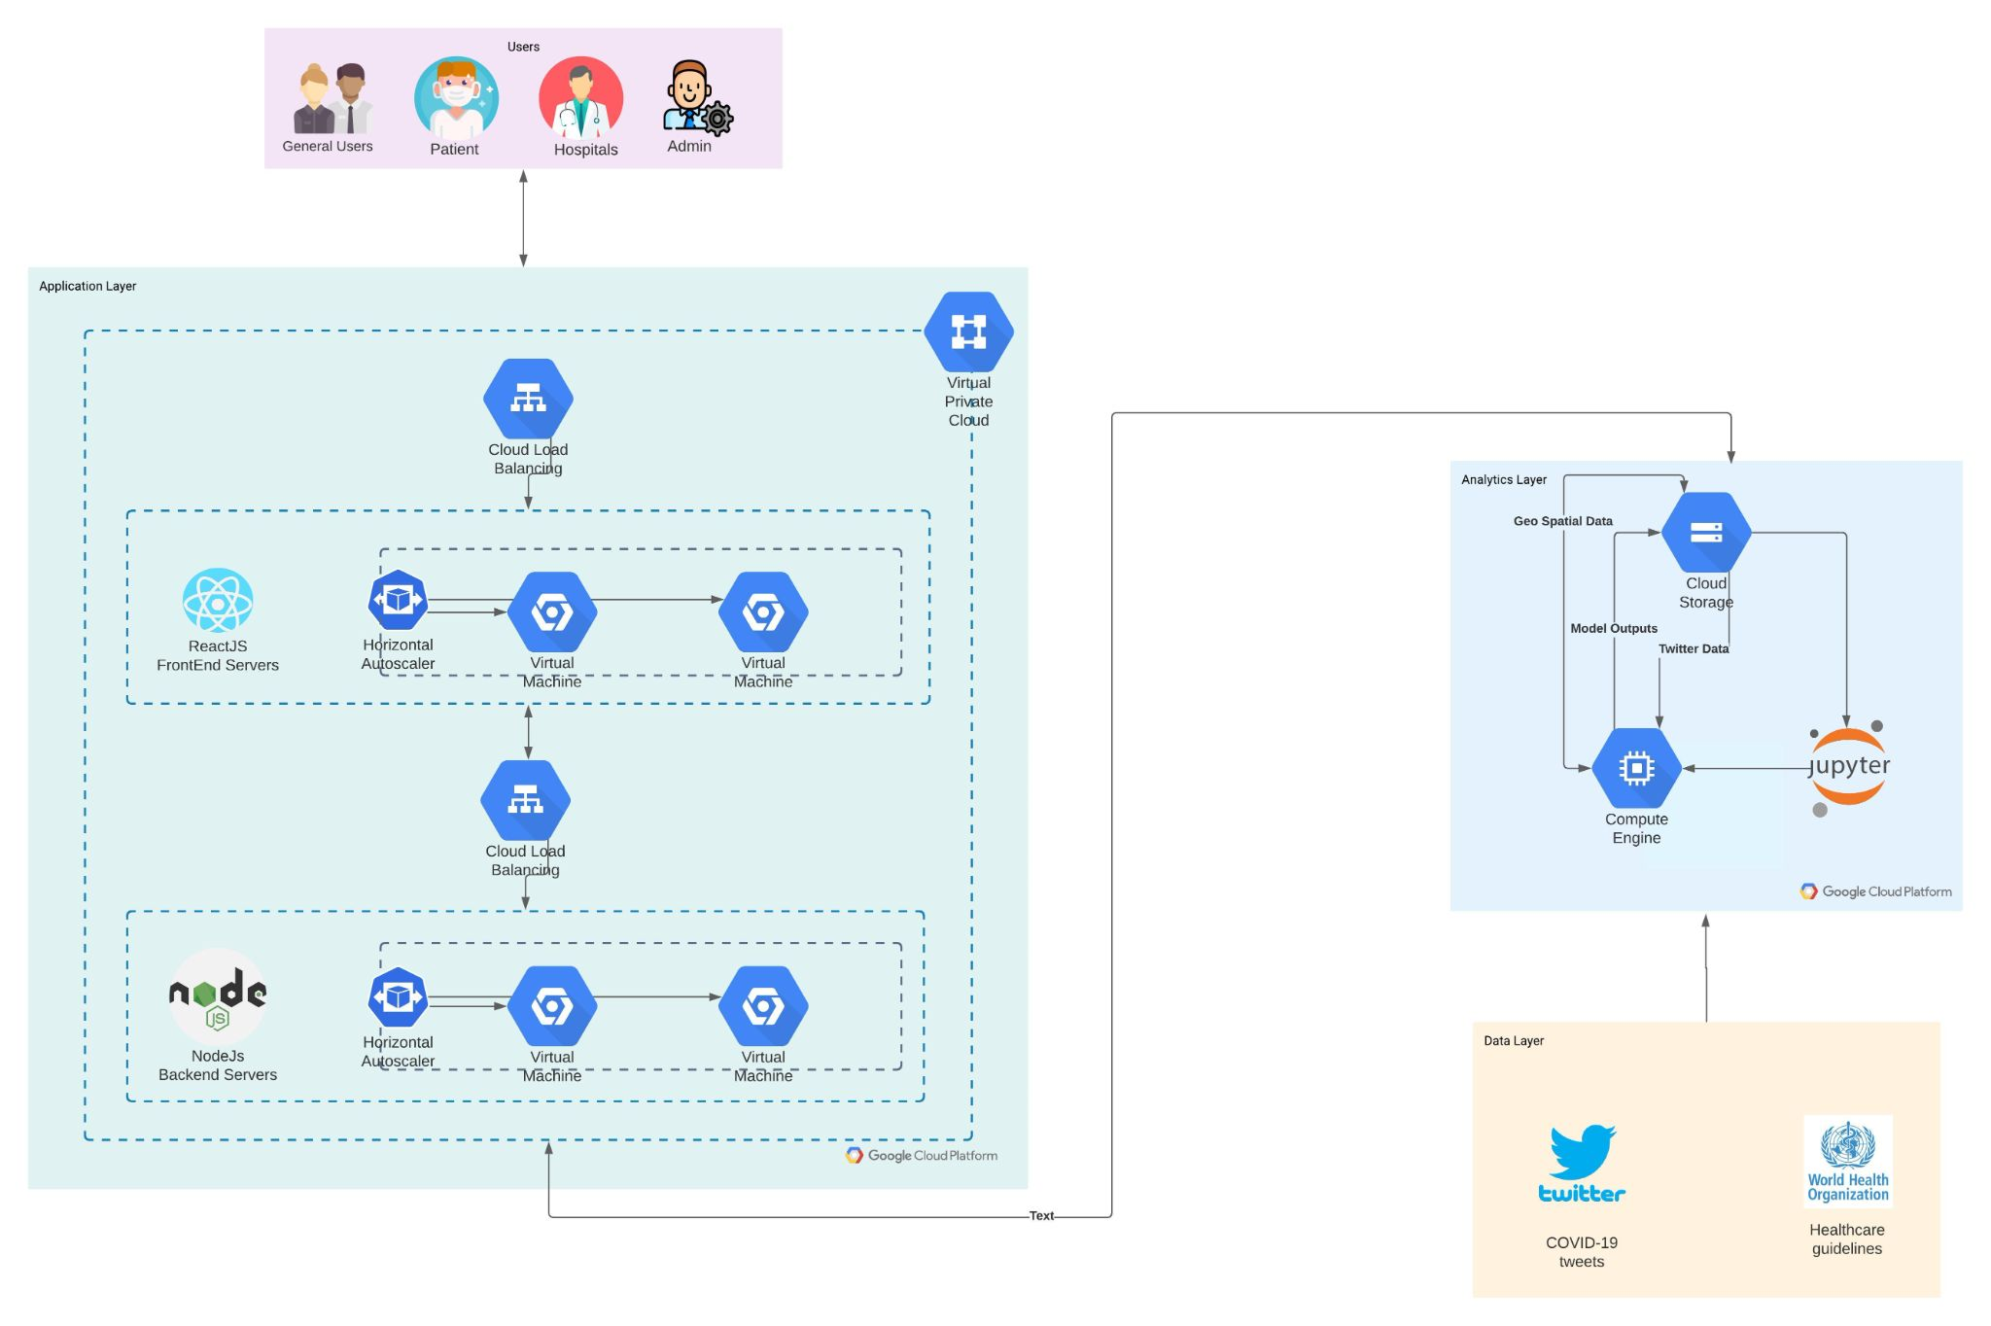
Architecture

Slide 4
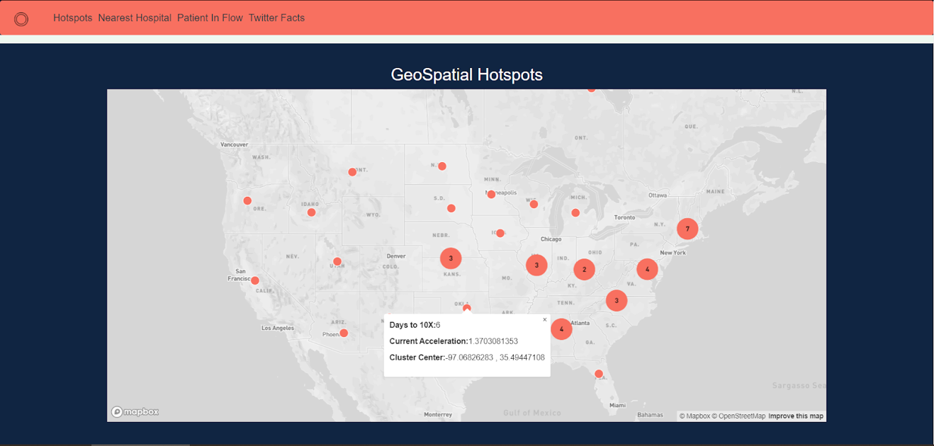
GeoSpatial Clustering
Getting the cases data from JHU
Using DBSCAN to form clusters
Displaying the clusters on map

Slide 5
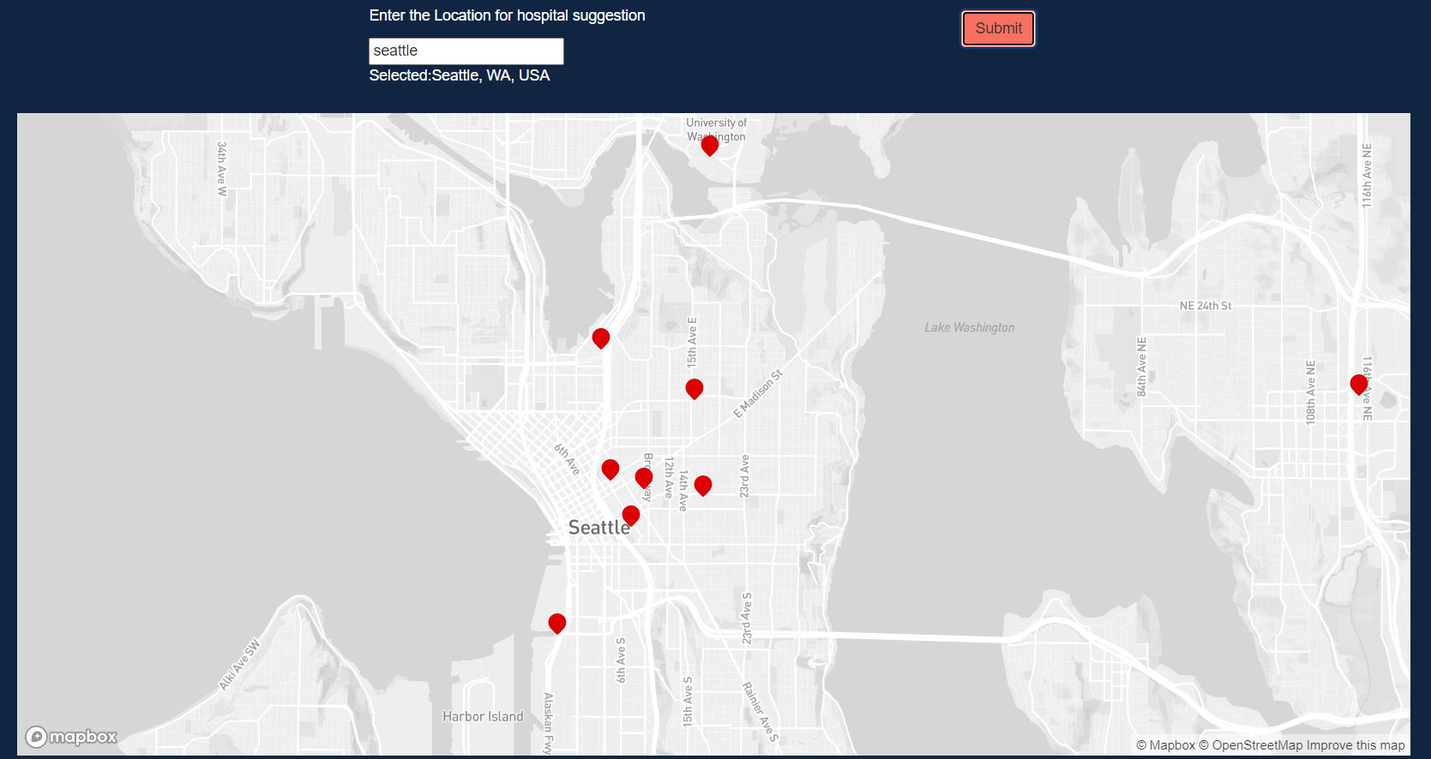
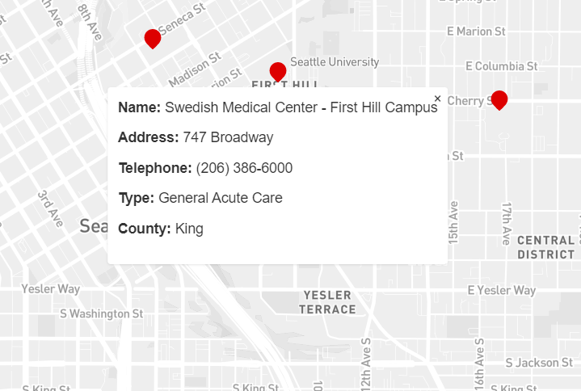
Nearest Hospital
Obtain the user location using text based suggestions
Display hospitals in the user’s vicinity
Provide details about the selected hospital on the map

Slide 6
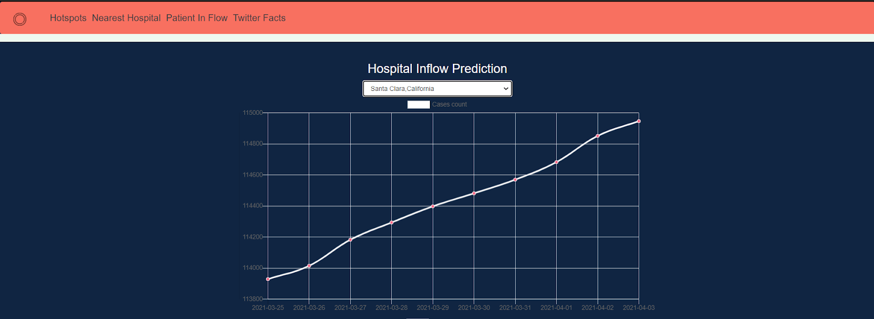

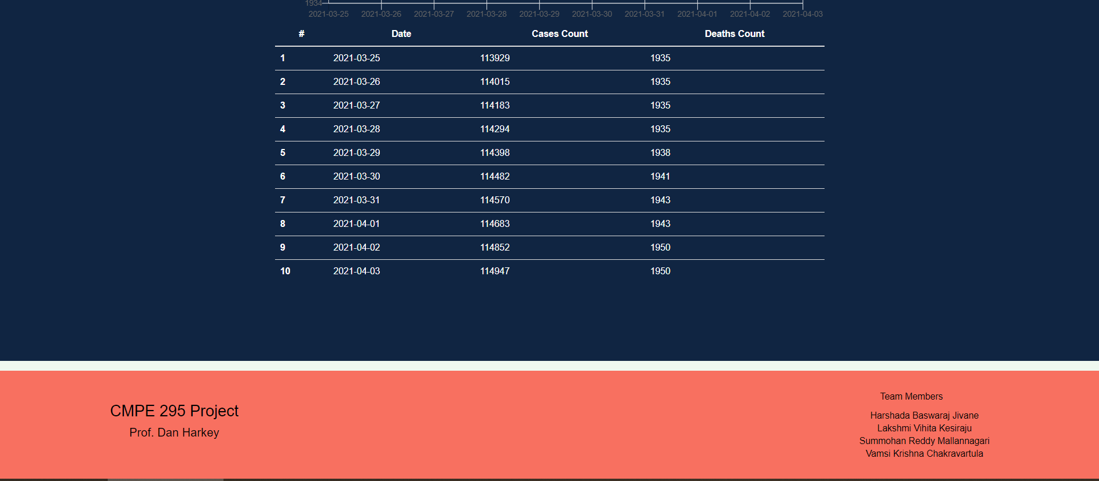
Patient Inflow
Patient Inflow is the prediction of possible cases in the coming days for every county of the United States.
The dataset used for this Prediction is a time series data.

Slide 7
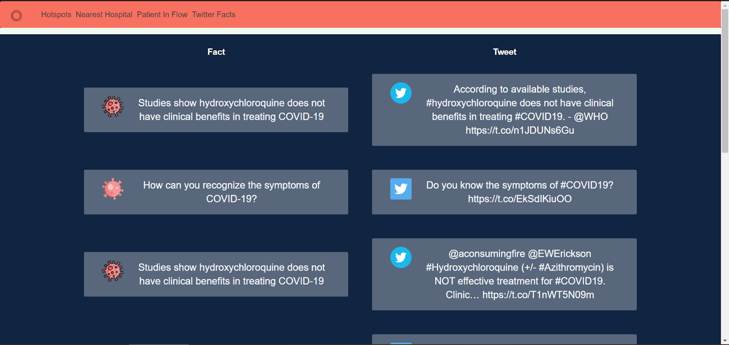
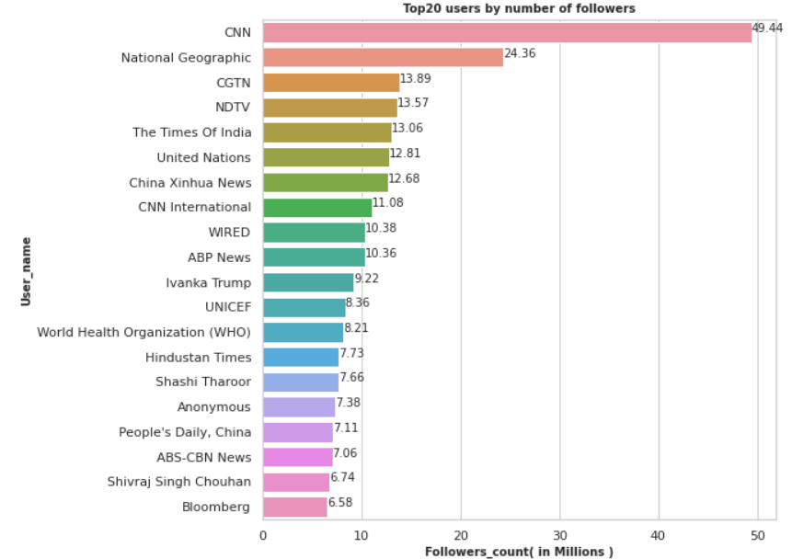
Twitter Correlations
Covid-19 tweets are extracted from Twitter.
Performing sentiment analysis.
News circulating regarding Covid-19.
The tweets are compared with the facts by WHO.

Slide 8
Evaluation Metrics
Silhouette Coefficient
Accuracy
Cosine Similarity

Slide 9
Conclusion
The pandemic has taken a toll on the healthcare system.
A predictive analysis-based web application that can support the hospitals with the surges in patient inflow, assist the public users in finding treatment and predict the hotspots based on the existing and historical admittance and infections data would be one of the project’s goals.
Our application would help users to understand the current situation and for the application of control policies.

Slide 10
Demo

Slide 11
Thank You

